Slide 1

K.S. SCHOOL OF ENGINEERING AND MANAGEMENT DEPARTMENT OF ELECTRONICS AND COMMUNICATION ENGINEERING Presentation on Title of the project Real Time Responsive Automated Window and Water Supply Operator for Indoor Plantations using IOT

Slide 2
Introduction
In the modern agricultural landscape, efficient resource management is crucial for sustainable farming practices. Our project focuses on developing a simple embedded system with multiple functions to address key agricultural challenges. The system is designed to automate irrigation and temperature control, thereby optimizing water usage and maintaining optimal environmental conditions for crops. The core components of this embedded system include:
Soil Moisture Sensor: This sensor continuously monitors the soil moisture levels. When the moisture level falls below a predefined threshold, it triggers a water pump to irrigate the soil automatically.
Water Pump: Activated by the soil moisture sensor, the water pump ensures that the soil maintains adequate moisture levels, reducing water wastage and improving crop health.
DHT11 Sensor: This sensor measures the ambient temperature. If the temperature exceeds a certain limit, it activates a stepper motor to open a window, allowing ventilation to cool down the environment.
Stepper Motor: Controlled by the DHT11 sensor, the stepper motor manages the opening and closing of a window to regulate the temperature.
By integrating these components, our embedded system provides an automated solution for efficient irrigation and temperature management. This project aims to enhance agricultural productivity, conserve water, and create a more sustainable farming environment.

Slide 3
Literature Review
Sl. No | Year of Publishing | Paper Name | Content | Authors
1. | 2018 | Automated Irrigation and Water Level Management System Using Raspberry Pi. | Adequate Irrigation improves food security crisis, maintains parks and sport-fields in good condition. The city of Cape Town in South Africa is currently experiencing water scarcity due to lack of rainfall. This has been affecting all living beings and plants. So, an Automated Irrigation and Water Level Management System is proposed using Raspberry Pi. | Nkosi,Sfiso H; Daniel Chowdhury.

Slide 4
2 | 1988 | "A Digital Hygrometer for Trace Moisture Measurement | A digital hygrometer using a polyimide capacitive humidity sensor is developed. The capacitance change of the sensor due to adsorption of water vapor in the atmosphere is detected by a switched-capacitor digital capacitance bridge. | T. Islam, A. U. Khan, J. Akhtar and M. Z. U. Rahman
3 | 2016 | Automated plant watering system | In daily operations related to farming or gardening Watering is the most important cultural practice and the most labor-intensive task. No matter whichever weather it is, either too hot and dry or too cloudy and wet, you want to be able to control the amount of water that reaches your plants | Divani, D., Patil, P., & Punjabi, S. K
3

Slide 5
4 | 2018 | Microcontroller based automated room light and fan controller. | Devices such as fan and lights will get turned on as soon as somebody enters the room and if the room is empty then it will get turned off. Above that, the speed of fan will be controlled according to the temperature of the surroundings. | Ratnadewi, R., Nurdiyanto, H., Najmurrokhman, A., Prabowo, C., Idmayanti, R., Eteruddin, H., Rahim, R.
5 | 2018 | Control and notification automatic water pump with arduino and SMS gateway | This paper aims to facilitate the owner to control water pump machine from the vacuum, and the condition of the water is it full or not in house or apartment. | Shashidhar R, Surendra R Hegde, Chinmaya K, Ankith Priyesh, A S Manjunath, B N Aruna Kumari

Slide 6
6 | 2023 | Fabrication and investigation of agricultural monitoring system with IoT & AI. | The goal of the research is to deploy a network of sensors throughout agricultural fields to gather real-time information on a variety of environmental factors including temperature, humidity, soil moisture and nutrient levels. | .Indira, P., Arafat, I. S., Karthikeyan, R., Selvarajan, S., & Balachandran, P. K
7 | 2023 | Smart agriculture – automatic monitoring of soil moisture and irrigation control for farming land | This paper is based on Raspberry Pi with a camera module and is programmed in python with the OpenCV library as a backend. First preprocessing of image taking place. Finally, the sign is identified using Tensor flow algorithm and outcome result as a voice using TTS algorithm. | Nagalingam, R., Chintamaneni, V., Paramasivan, K., & Ponnusamy, M.

Slide 7
Problem Statement
In agriculture, efficient resource management and environmental control are paramount for maximizing crop yield and ensuring sustainable practices. Traditional methods often fall short in several key areas, leading to significant challenges:
Inefficient Water Usage:
Traditional irrigation methods often result in water wastage due to over-irrigation or under-irrigation.
Manual monitoring of soil moisture levels is labor-intensive and prone to inaccuracies.
Inconsistent Temperature Regulation:
Maintaining optimal temperature conditions manually is difficult, especially in changing environmental conditions.
Lack of automated solutions for temperature control can negatively impact crop health and productivity.

Slide 8
Block Diagram
Temperature and Humidity Sensor
Soil Moisture level Sensor
Arduino UNO
16*2 LED Display
Window operator motor(Stepper motor)
Water Pump
(Drip System)

Slide 9
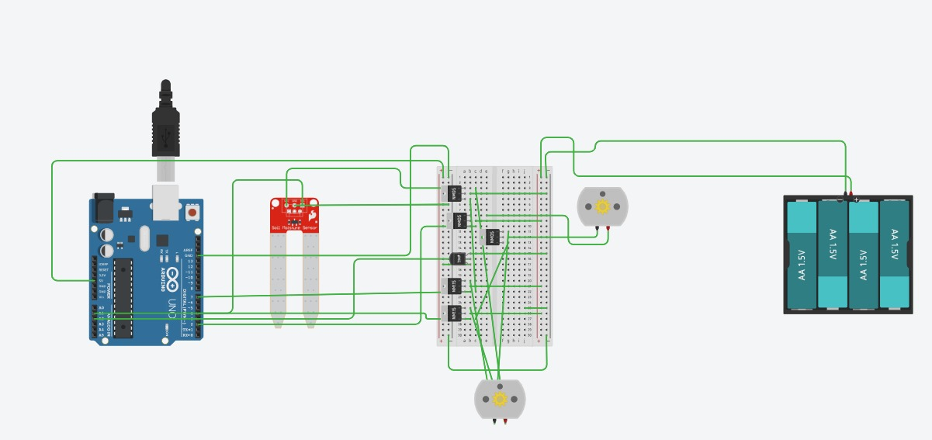
Interfacing

Slide 10
Hardware and Software
Hardware requirements
Arduino UNO
Soil Moisture sensor
Water pump
DHT11 sensor
Stepper motor and driver
Bread Board
Jumper Wires
Software requirements
Arduino IDE
Tinker-CAD simulator

Slide 11
Conclusion & Future Scope
Conclusion
The project "Real Time Responsive Automated Window and Water Supply Operator for Indoor Plantations using IoT" has successfully demonstrated the feasibility and effectiveness of integrating IoT technologies into indoor farming environments. Throughout the development and implementation phases, several key achievements and findings have emerged:
Automation and Efficiency: By automating the control of windows and water supply based on real-time environmental data (such as, soil moisture, and temperature), the system has significantly improved operational efficiency in indoor plantations. This automation reduces manual intervention, optimizes resource utilization, and enhances crop health and growth.
Reliability and Responsiveness: Through rigorous testing and validation, the system has proven to be reliable and responsive under various environmental conditions. It effectively adjusts window openings and water supply mechanisms in real-time, ensuring that plants receive optimal conditions for growth.
User Interface and Interaction: The development of a user-friendly interface has empowered users to monitor and manage the indoor plantation environment effortlessly. Features such as remote monitoring, setting preferences, and receiving alerts have enhanced user experience and control over the system.
Challenges and Solutions: Challenges encountered during the project, including hardware limitations and connectivity issues, were systematically addressed. Solutions implemented have improved system robustness and performance.

Slide 12
Future Scope
Advanced Sensor Integration: Incorporating advanced sensors for more precise environmental monitoring (e.g., CO2 levels, nutrient concentrations) can further optimize plant growth conditions.
Predictive Analytics and Machine Learning: Implementing predictive analytics and machine learning algorithms can anticipate environmental changes and optimize system responses proactively.
Energy Efficiency: Exploring energy-efficient technologies (such as solar-powered components or energy harvesting) can reduce operational costs and environmental impact.
Scalability and Adaptability: Scaling the system for larger indoor plantations or adapting it to different crops and environments will broaden its applicability and impact.
IoT Platform Enhancements: Continuously updating and integrating with advanced IoT platforms to leverage new features and capabilities in data analytics and management.
Community and Industry Collaboration: Collaborating with indoor farming communities and industry stakeholders can foster innovation and adoption of IoT-driven solutions in agriculture.

Slide 13
Advantages , Applications, Limitations
Advantages:
Saves manual monitoring time.
Ensures atmospheric parameter's quality.
No extra labor cost required for the operation.
Safe protection from weather disruptions such as heavy rain, storms, strong winds etc.
Applications :
The project targets indoor farms and plantation nurseries .
Targeted specially on indoor plantation farms that are located in remote areas or in countries where water scarcity is serious factor.
This set-up of the project can be alternatively modified to captivate endangered species of animals such as rare apes, birds, fish that are breed in captivation of specific temperature habitats.
Limitations :
Cost of maintenance can be high cause of faulty components.
Normal gardener / Normal Zoo-keeper cannot operate the system without specific training/certified knowledge about IOT.
Margin for accuracy errors and risk factors of system fail is always to be considered.

Slide 14
References
[1] H. Shimizu, H. Matsumoto, M. Asakura and K. Watanabe, "A digital hygrometer," in IEEE Transactions on Instrumentation and Measurement, vol. 37, no. 2, pp. 300-304, June 1988, doi: 10.1109/19.6071.
[2] T. Islam, A. U. Khan, J. Akhtar and M. Z. U. Rahman, "A Digital Hygrometer for Trace Moisture Measurement," in IEEE Transactions on Industrial Electronics, vol. 61, no. 10, pp. 5599-5605, Oct. 2014, doi: 10.1109/TIE.2013.2297295.
[3] Divani, D., Patil, P., & Punjabi, S. K. (2016/04//). Automated plant watering system. The Institute of Electrical and Electronics Engineers, Inc.(IEEE) Conference Proceedings., , 180-182. Doi:https://doi.org/10.1109/ICCPEIC.2016.7557245.
[4] Roy, P., Saha, J., Dutta, N., & Chandra, S. (2018). Microcontroller based automated room light and fan controller. Piscataway: The Institute of Electrical and Electronics Engineers, Inc. (IEEE).
[5] UV water treatment. (2001/05/31/). Process Cooling & Equipment (Online),
[6] Silva, R. G., Szabo, J., Namboodiri, V., Krishnan, E. R., Rodriguez, J., & Zeigler, A. (2018/06//). Evaluation of an environmentally sustainable UV-assisted water treatment system for the removal of bacillus globigii spores in water. Water Science & Technology, 18(3), 968-975. doi:https://doi.org/10.2166/ws.2017.165

Slide 15
[7] Ratnadewi, R., Nurdiyanto, H., Najmurrokhman, A., Prabowo, C., Idmayanti, R., Eteruddin, H., . . . Rahim, R. (2018/08//). Control and notification automatic water pump with arduino and SMS gateway. IOP Conference Series.Materials Science and Engineering, 407(1) doi:https://doi.org/10.1088/1757-899X/407/1/012160
[8] Sen, S., & Dasgupta, A. (2022). Automatic irrigation system with water-level indicator and IOT enabled humidity lodger. Piscataway: The Institute of Electrical and Electronics Engineers, Inc. (IEEE). doi:https://doi.org/10.1109/DELCON54057.2022.9753499
[9] Indira, P., Arafat, I. S., Karthikeyan, R., Selvarajan, S., & Balachandran, P. K. (2023/12//). Fabrication and investigation of agricultural monitoring system with IoT & AI. SN Applied Sciences, 5(12), 322. doi:https://doi.org/10.1007/s42452-023-05526-1
[10]Nagalingam, R., Chintamaneni, V., Paramasivan, K., & Ponnusamy, M. (2023/12//). Smart agriculture – automatic monitoring of soil moisture and irrigation control for farming land. Current Agriculture Research Journal, 11(3) doi:https://doi.org/10.12944/CARJ.11.3.30

Slide 16
Thank You

